Slide 1

ARTIFICIAL VISION ROVER TEAM SPAZIO

Slide 2
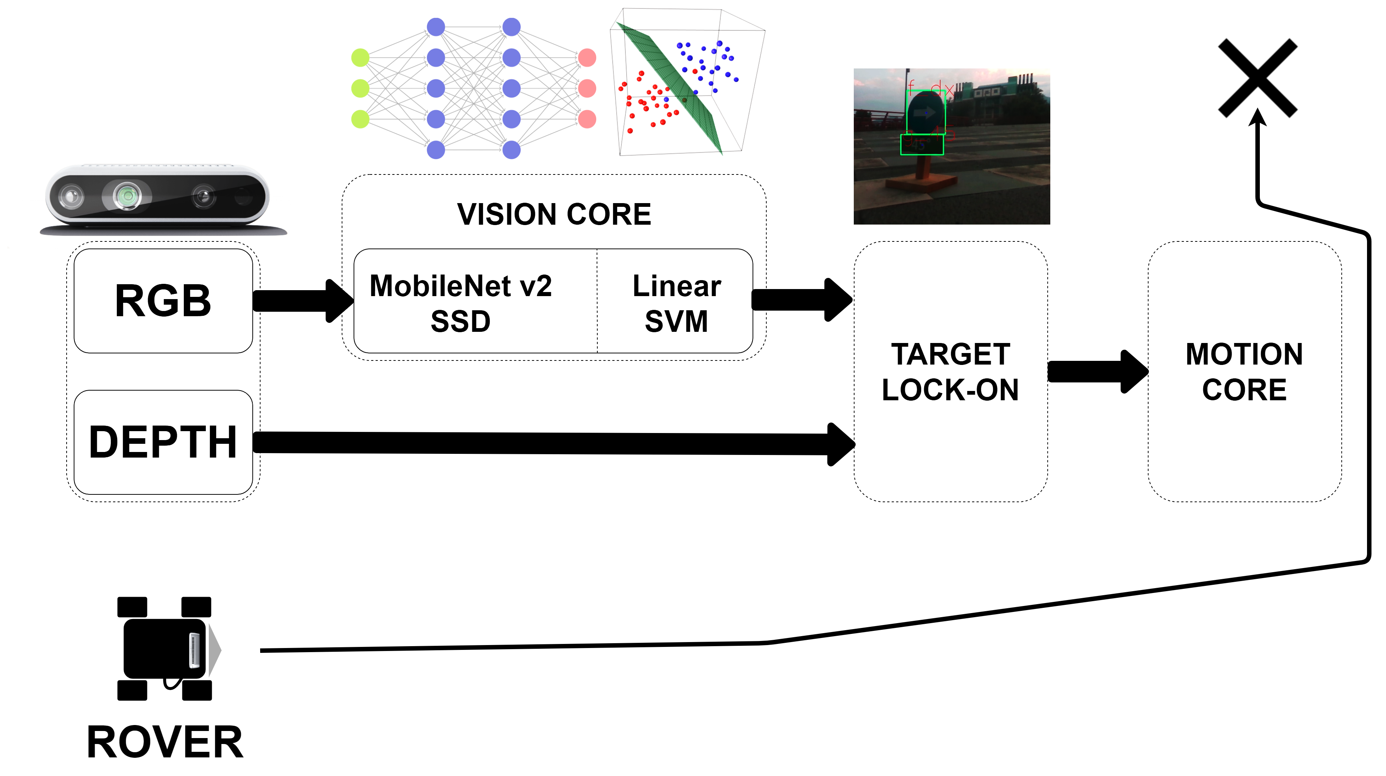
HIGH-LEVEL DESIGN What’s going on?

Slide 3
VISION NODE Look around.
MOBILENET V2 SSD
DEEP NEURAL NETWORK
7 class recognized
Transfer learning from COCO dataset
12000 iterations
Train set: 15900 positive samples
Data augmentation on brightness, contrast, hue and saturation
6 different grid layers
5 different aspect layers
LINEAR SVM
Number of door sign recognition
Degrees sign recognition
Train set: 7000 positive images
HOG features

Slide 4
WHY USE SVM TOO?
Some would say it’s redundant…

Slide 5
WHY USE SVM TOO? ONLY DNN vs DNN+SVM SCORES
ONLY DEEP NEURAL NETWORK SCORES
CLASS PRECISION RECALL F1_SCORE
no_entry 1.000 0.671 0.803
f_dx 0.941 0.829 0.881
f_sx 0.913 0.901 0.907
f_up 0.676 0.548 0.605
g_0 0.909 0.526 0.667
g_180 0.632 0.456 0.529
g_45 0.939 0.733 0.823
g_90 0.936 0.791 0.857
n_1 0.900 0.200 0.327
n_2 0.860 0.343 0.490
n_3 0.577 0.254 0.353
n_4 0.556 0.435 0.488
n_5 0.630 0.582 0.605
n_6 0.788 0.588 0.673
wall 0.911 0.887 0.899
DEEP NEURAL NETWORK + LINEARSVM SCORES
CLASS PRECISION RECALL F1_SCORE
no_entry 1.000 0.658 0.794
f_dx 0.755 0.770 0.762
f_sx 0.851 0.781 0.815
f_up 0.694 0.595 0.641
g_0 0.521 0.658 0.581
g_180 0.867 0.494 0.629
g_45 0.880 0.651 0.748
g_90 0.961 0.794 0.870
n_1 0.975 0.867 0.918
n_2 0.972 0.734 0.837
n_3 0.833 0.339 0.482
n_4 0.357 0.435 0.392
n_5 0.841 0.873 0.857
n_6 0.961 0.868 0.912
wall 0.965 0.726 0.829

Slide 6
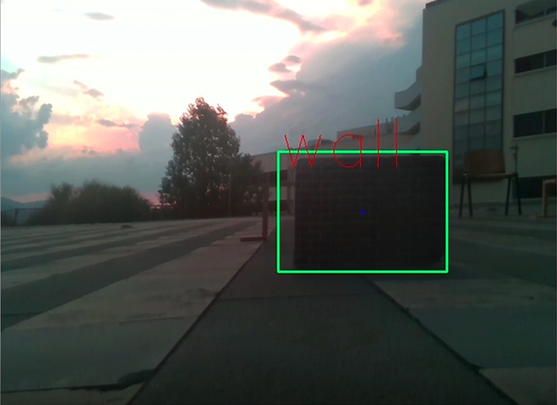
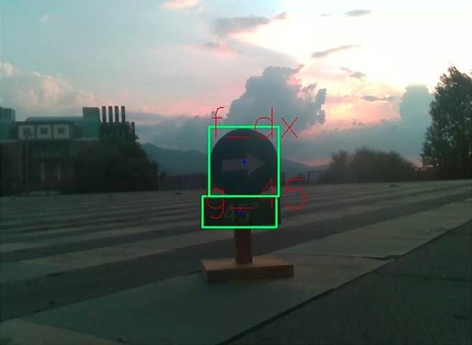
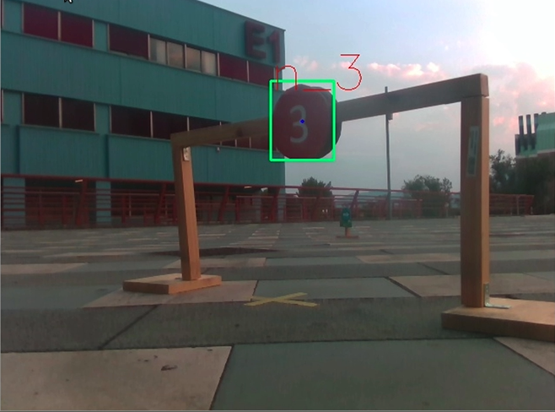
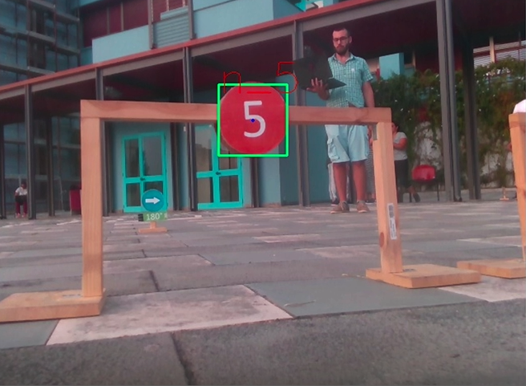
TARGET LOCK-ON Combat-ready!

Slide 7
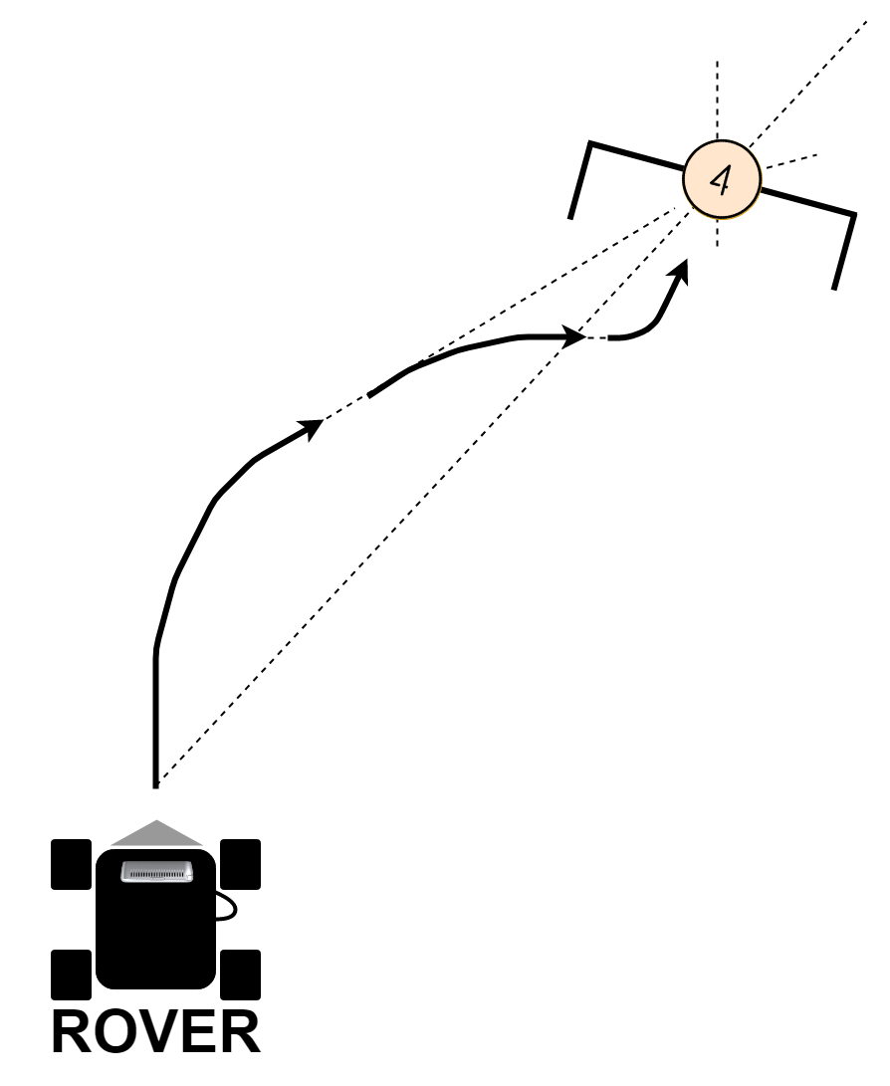
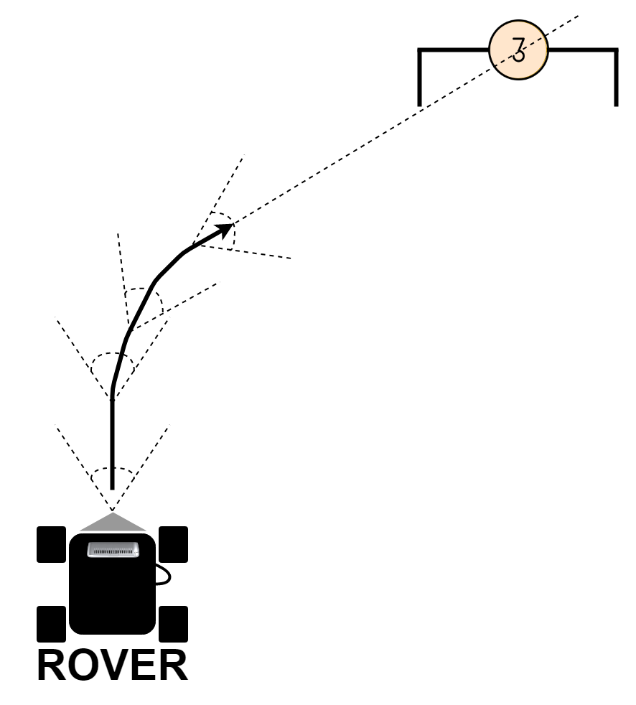
MOTION CORE Achieve your target!
Alignment correction
Distortion correction on door

Slide 8
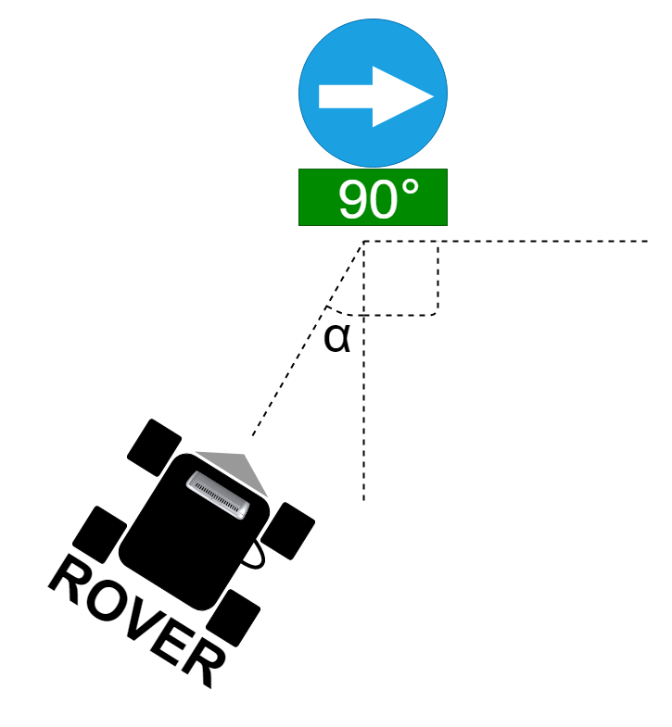
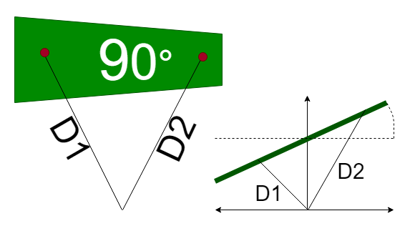
MOTION CORE Achieve your target!
Distortion measurement
Distortion correction on sign

Slide 9
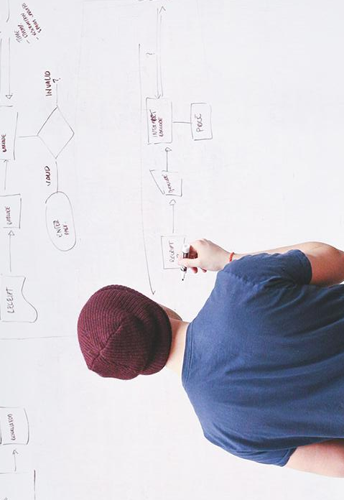
THANKS!
TEAM SPAZIO
ALLEGRETTI GIOVANNI
DI DOMENICO FABRIZIO
DI PRISCO GIOVANNI
SCHETTINI MARCO

Slide 10
HELLO!
I am Jayden Smith
I am here because I love to give presentations.
You can find me at @username

Slide 11
1.
TRANSITION HEADLINE
Let’s start with the first set of slides

Slide 12
“Quotations are commonly printed as a means of inspiration and to invoke philosophical thoughts from the reader”

Slide 13
This is a slide title
Here you have a list of items
And some text
But remember not to overload your slides with content
Your audience will listen to you or read the content, but won’t do both.

Slide 14
BIG CONCEPT
Bring the attention of your audience over a key concept using icons or illustrations

Slide 15
You can also split your content
White
Is the color of milk and fresh snow, the color produced by the combination of all the colors of the visible spectrum.
Black
Is the color of coal, ebony, and of outer space. It is the darkest color, the result of the absence of or complete absorption of light.

Slide 16
In two or three columns
Yellow
Is the color of gold, butter and ripe lemons. In the spectrum of visible light, yellow is found between green and orange.
Blue
Is the colour of the clear sky and the deep sea. It is located between violet and green on the optical spectrum.
Red
Is the color of blood, and because of this it has historically been associated with sacrifice, danger and courage.

Slide 17
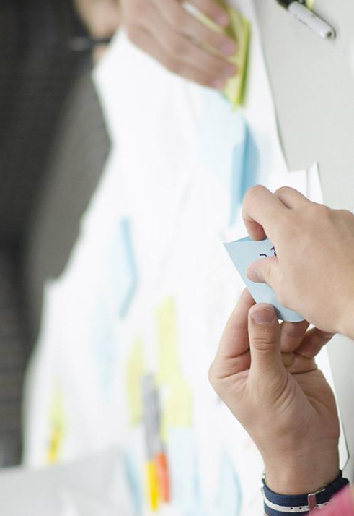
A picture is worth a thousand words
A complex idea can be conveyed with just a single still image, namely making it possible to absorb large amounts of data quickly.

Slide 18

Want big impact?
USE BIG IMAGE

Slide 19
Use charts to explain your ideas
White
Gray
Black

Slide 20
And tables to compare data
 | A | B | C
Yellow | 10 | 20 | 7
Blue | 30 | 15 | 10
Orange | 5 | 24 | 16

Slide 21
Maps
our office

Slide 22
89,526,124
Whoa! That’s a big number, aren’t you proud?

Slide 23
89,526,124$
185,244 users
100%
That’s a lot of money
And a lot of users
Total success!

Slide 24
Our process is easy
FIRST
SECOND
LAST

Slide 25
Let’s review some concepts
Yellow
Is the color of gold, butter and ripe lemons. In the spectrum of visible light, yellow is found between green and orange.
Blue
Is the colour of the clear sky and the deep sea. It is located between violet and green on the optical spectrum.
Red
Is the color of blood, and because of this it has historically been associated with sacrifice, danger and courage.
Yellow
Is the color of gold, butter and ripe lemons. In the spectrum of visible light, yellow is found between green and orange.
Blue
Is the colour of the clear sky and the deep sea. It is located between violet and green on the optical spectrum.
Red
Is the color of blood, and because of this it has historically been associated with sacrifice, danger and courage.

Slide 26
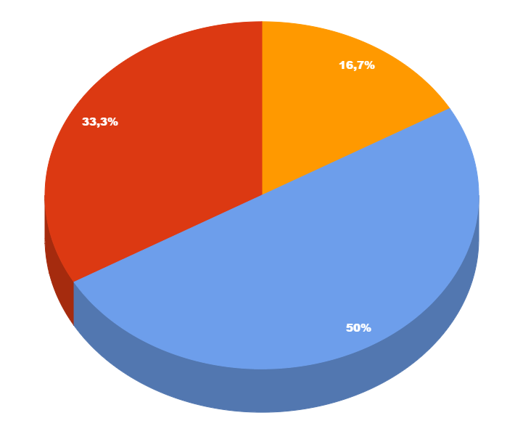
You can copy&paste graphs from Google Sheets

Slide 27
ANDROID PROJECT
Show and explain your web, app or software projects using these gadget templates.
Place your screenshot here

Slide 28
iPHONE PROJECT
Show and explain your web, app or software projects using these gadget templates.
Place your screenshot here

Slide 29
TABLET PROJECT
Show and explain your web, app or software projects using these gadget templates.
Place your screenshot here

Slide 30
DESKTOP PROJECT
Show and explain your web, app or software projects using these gadget templates.
Place your screenshot here

Slide 31
Credits
Special thanks to all the people who made and released these awesome resources for free:
Presentation template by SlidesCarnival
Photographs by Startupstockphotos

Slide 32
Presentation design
This presentation uses the following typographies:
Titles: Hind
Body copy: Hind
You can download the fonts on this page:
https://www.fontsquirrel.com/fonts/hind
You don’t need to keep this slide in your presentation. It’s only here to serve you as a design guide if you need to create new slides or download the fonts to edit the presentation in PowerPoint®

Slide 33
SlidesCarnival icons are editable shapes.
This means that you can:
Resize them without losing quality.
Change fill color and opacity.
Change line color, width and style.
Isn’t that nice? :)
Examples:

Slide 34
😉
Now you can use any emoji as an icon!
And of course it resizes without losing quality and you can change the color.
How? Follow Google instructions https://twitter.com/googledocs/status/730087240156643328
✋👆👉👍👤👦👧👨👩👪💃🏃💑❤😂😉😋😒😭👶😸🐟🍒🍔💣📌📖🔨🎃🎈🎨🏈🏰🌏🔌🔑 and many more...

